Slide 1

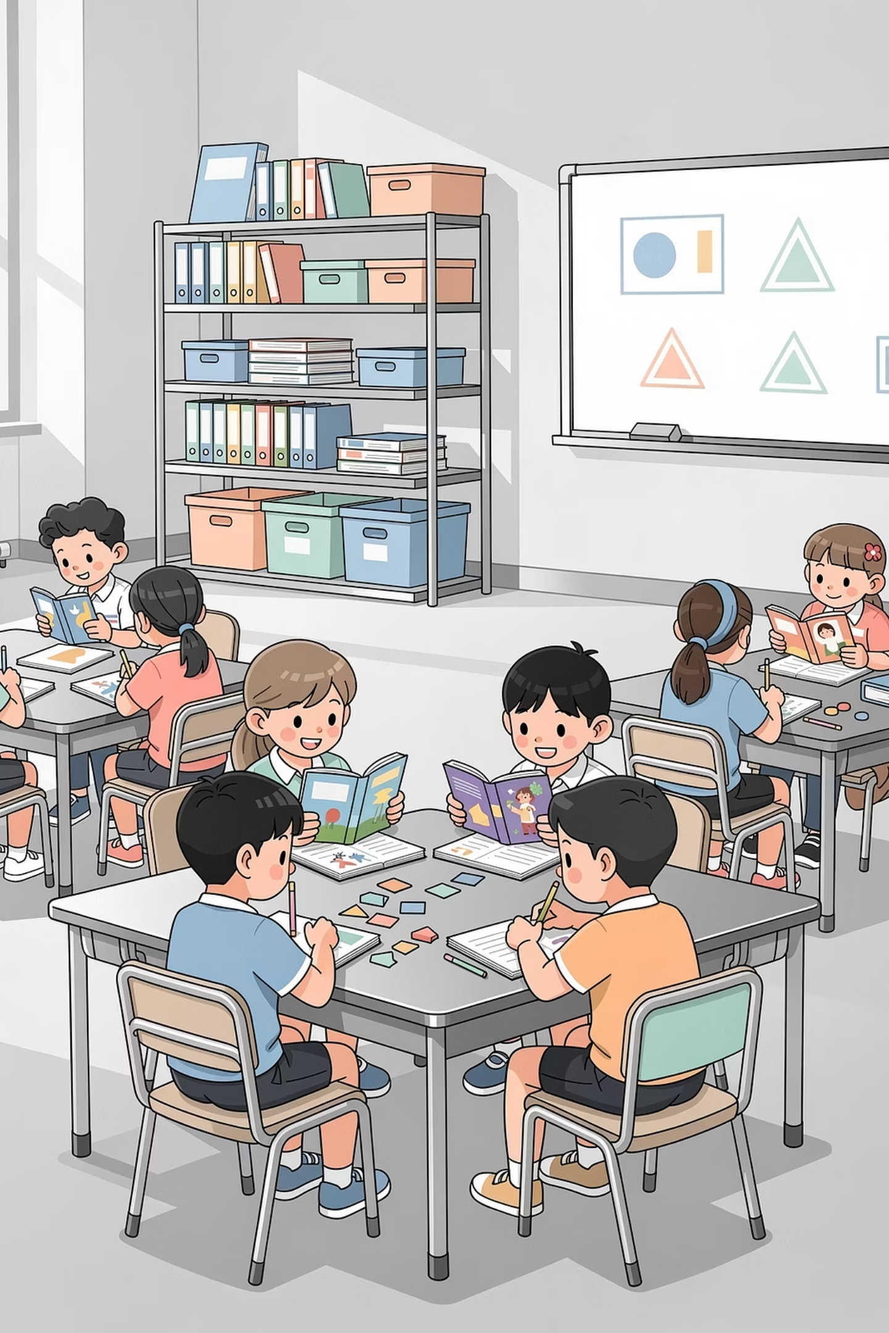
Effective Safeguarding Culture Model
Kingsway Primary School · Davyhulme, Urmston · M41 0SP
"Inspired to Make a Difference Together"

Slide 2

Our Purpose, Vision & Values
Our Purpose
Our Values — Linked to Safeguarding
To provide a clear framework for all aspects of safeguarding — moving from a tick-box compliance approach to an effective safeguarding culture, deeply embedded within every area of our school.
We care about Togetherness
Safeguarding is everyone's shared responsibility — no one works alone.
Our Vision
That Kingsway has an effective culture of safeguarding where all staff fully understand and carry out their responsibilities. Children feel safe and secure — physically and emotionally — providing firm foundations for growth as learners.
We thrive on Difference
We celebrate and protect every child's unique identity and needs.
We are passionate about Learning
Safety is the foundation upon which all learning is built.
We are inspired to Grow
We grow our safeguarding knowledge and practice continuously.

Slide 3

Kingsway in Context
195
Pupils on Roll
One-form entry primary with nursery, ages 3–11
36%
Free School Meals
33–37% of pupils eligible
21%
EAL Pupils
English as an Additional Language
21%
SEN Pupils
Including specialist SLCN & SEMH resourced provision
Kingsway is part of the Inspiring Learners Multi Academy Trust, located in Davyhulme within Trafford Local Authority. Our small school size enables staff to know every pupil and family well, supporting early identification and timely intervention.

Slide 4
Our Safeguarding Vision in Action
At Kingsway, everyone takes responsibility for keeping children and each other safe. We believe children will only achieve excellence if they feel safe and secure.
Notice
Take Action
Follow Through
Be alert to signs of risk or harm in every interaction and environment.
Follow reporting systems promptly — never ignore a concern, however small.
Ensure concerns are tracked, escalated and resolved with children at the centre.
Relational Approach
Whistle Blowing
Pastoral, Mental Health & Well-being Team
Preventative Measures

Slide 5
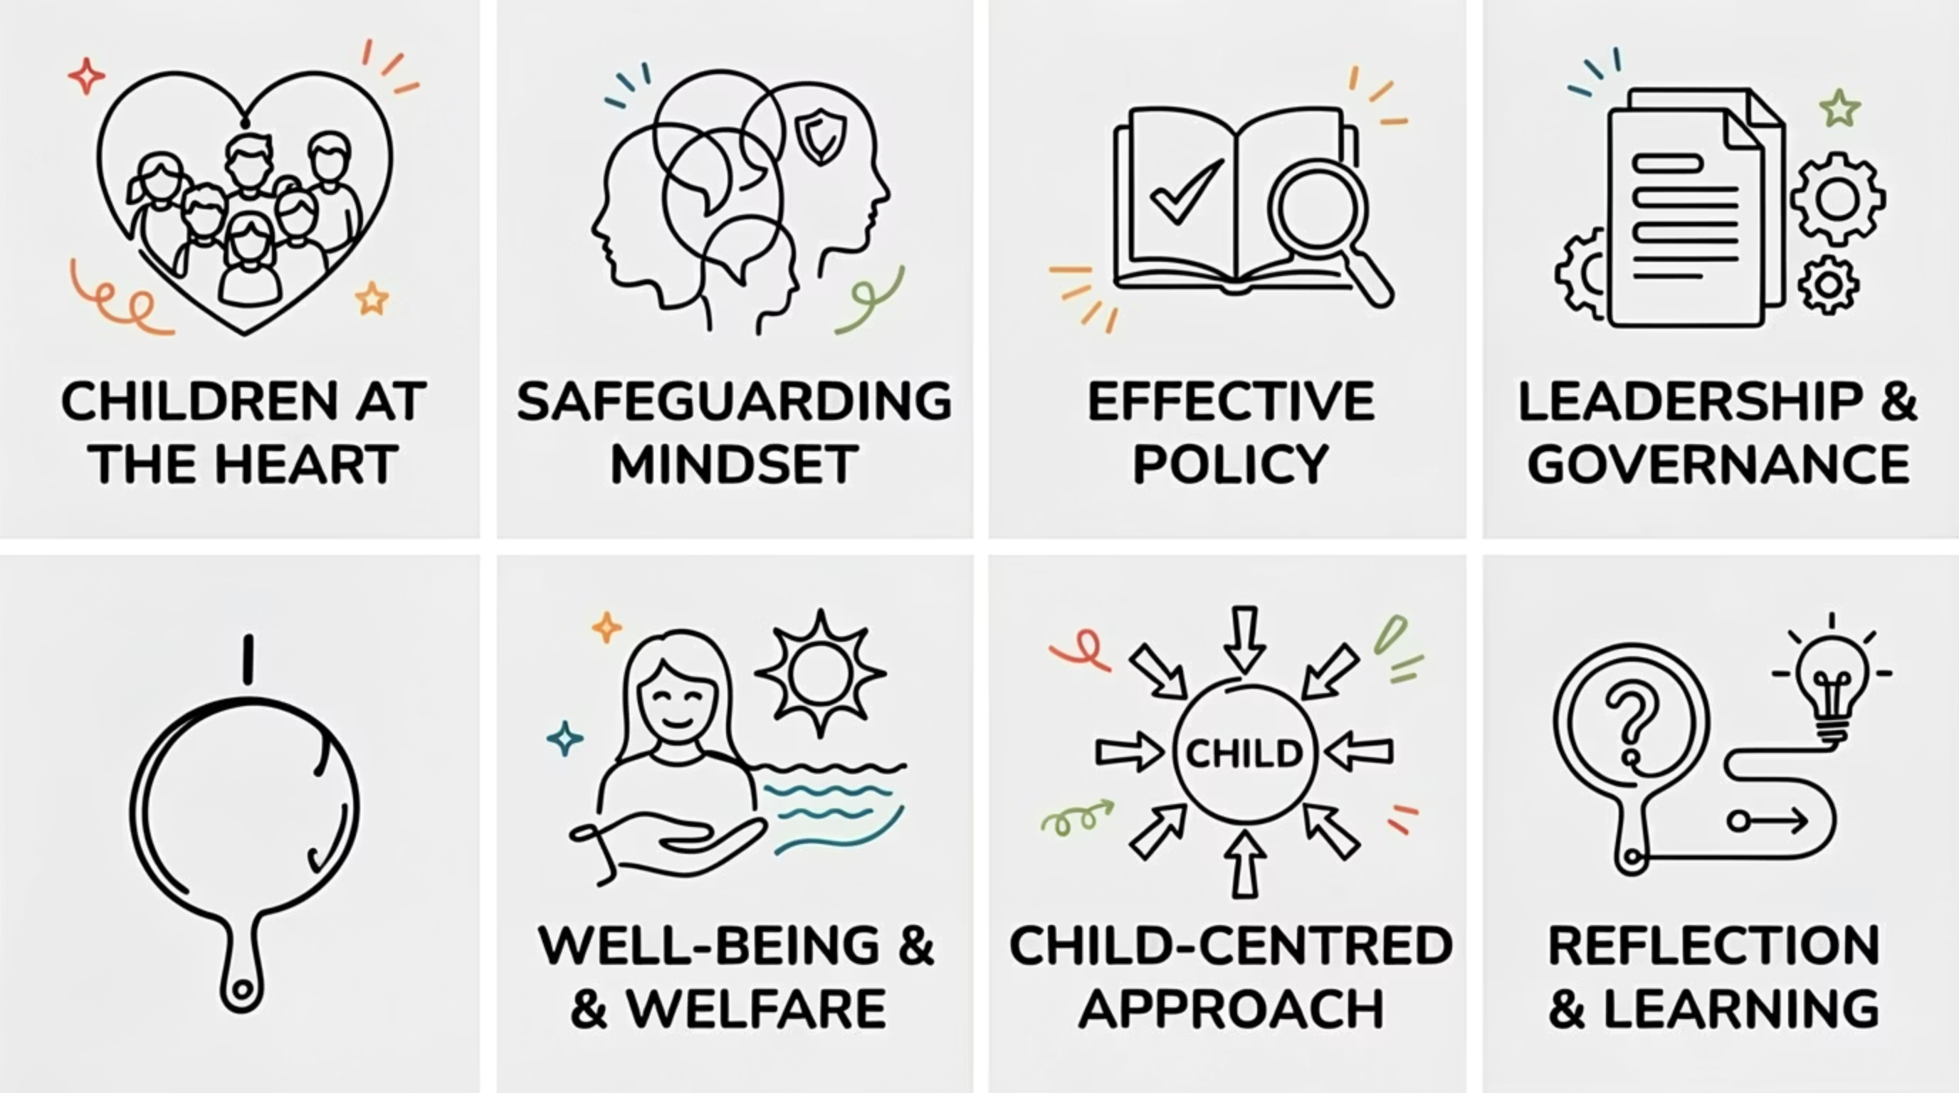

The Seven Pillars of Effective Safeguarding Culture
Our model is built on seven interconnected pillars, each essential to creating a safeguarding culture that goes beyond compliance.

Slide 6
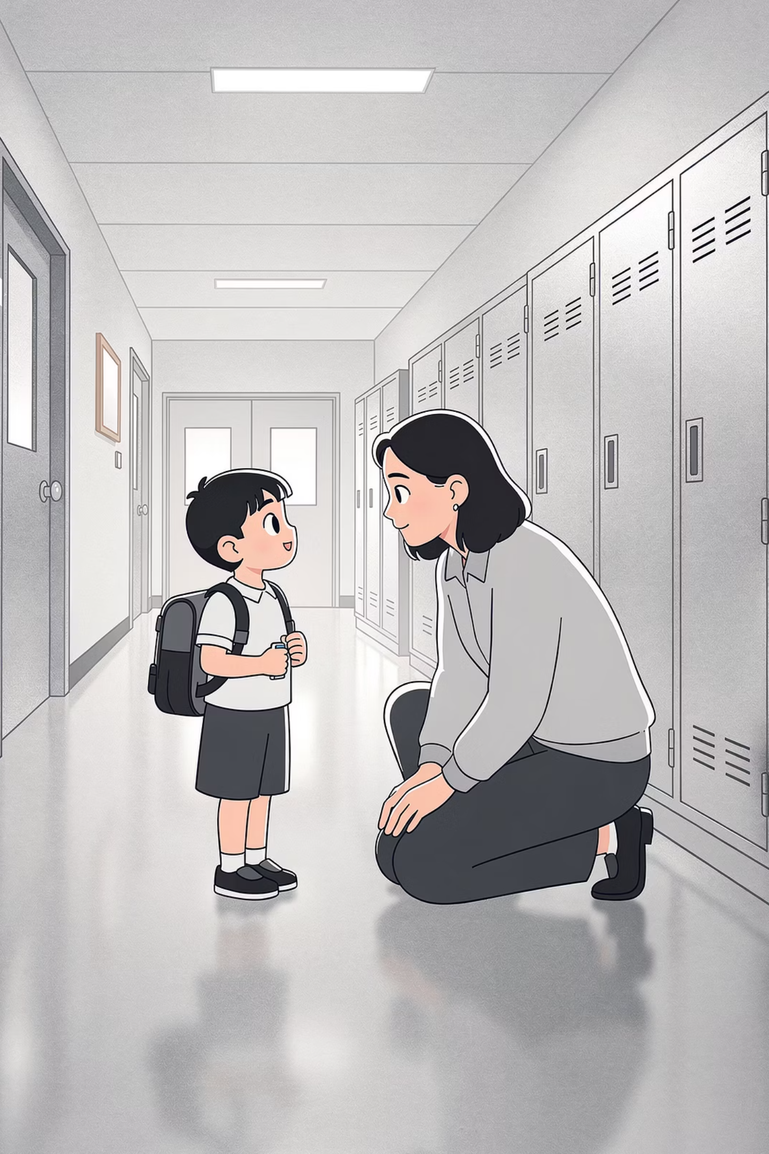
Children at the Heart of Everything
Paramount Welfare
Ofsted Recognition (March 2023)
Everyone believes the welfare of children is paramount
The needs and rights of children are at the heart of all decisions
Children are empowered to speak up and self-advocate
Children's views are valued — they are heard and believed
"Pupils' well-being is at the heart of this school."
Ofsted confirmed that safeguarding is effective at Kingsway. Pupils feel safe, valued and listened to. Staff are alert to signs of risk and diligently follow the school's reporting system. Leaders work effectively with external agencies to ensure timely support for pupils and families.

Slide 7
Safeguarding Ethos, Mindset & Compliance
Ethos & Mindset
Policies, Procedures & Compliance
"People, not policies, keep children safe" — leaders and staff believe it could happen here
Values, behaviours and professional boundaries are clearly communicated
Commitment to safeguarding is visible and felt throughout school
Parents and carers are supported to understand safeguarding, including online safety
Fully aligned with Keeping Children Safe in Education (2024) and Working Together (2023)
Robust Child Protection Policy reviewed annually at trust level
Low-level concerns, allegations and whistle-blowing policies in place and accessible
"What to do if you are concerned" information visible throughout school
Policies regularly reviewed — asking "So What?"

Slide 8



Leadership, Welfare & Coordinated Approach
Effective Leadership & Governance
Welfare & Well-being
Child Centred & Coordinated
Leaders at all levels role-model the school's values. Every leader sees safeguarding as their responsibility. Leaders create an open culture, are courageous in acting on concerns, and prioritise children's safety alongside attainment.
Staff wellbeing is a priority, discussed openly with actions taken. Pastoral care is coordinated by our Pastoral Lead and Family Support Worker. A relational approach — empathy, care and safe environments — is role-modelled at all levels.
School works in partnership with parents, carers and statutory agencies. Information is shared openly in children's best interests. Staff receive training on the effects of trauma and poor attachment on children's well-being.

Slide 9
Evaluation, Reflection & Our Safeguarding Team
Evaluation & Learning
Our Safeguarding Team
Kingsway is an open, learning organisation — self-reflection and learning from mistakes is celebrated
Supervision is embedded within our well-being culture
Regular internal and external safeguarding reviews and audits
Lessons learnt are shared with all staff, leaders and governors
Safeguarding training is contextually relevant and makes a positive impact
01
1 × Designated Safeguarding Lead (DSL)
02
5 × Deputy DSLs (DDSLs)
03
Curriculum Contribution
1 × Attendance Lead
PSHE and Personal Development are carefully sequenced so pupils understand how to stay safe, seek help and recognise online risks. Ofsted confirmed pupils are confident to raise concerns and trust adults to act.
04
1 × Pastoral Lead / Family Support Worker
05
1 × ELSA (Emotional Literacy Support Assistant)

Slide 10


Our Commitment — Safeguarding is Everyone's Responsibility
Strong Culture
Values-led safeguarding embedded in daily practice, not just policy.
Trusted Adults
Pupils know who to turn to and are confident adults will act.
Early Intervention
Small school context enables personalised, timely support for every child.
Continuous Improvement
Ongoing review, training and partnership keep our practice sharp and effective.
Ofsted (March 2023): "The arrangements for safeguarding are effective." All staff understand their role, use training to identify risk, and leaders work effectively with external agencies to ensure pupils and families receive timely support. Pupils understand how to protect themselves online and know what to do if something upsets them.

