Slide 1

A Year of Reading for Pleasure
Celebrating what we've built together — and looking ahead
At the close of a remarkable year, we gather to celebrate the passion, dedication, and shared love of books that has transformed our school into a truly book-led community. This is our story.

Slide 2


An Environment That Oozes Reading
From the moment anyone steps through our front door, books are everywhere. Our entrance welcomes visitors with carefully curated displays; corridors tell stories through covers, quotes, and artwork; offices hold shelves of well-loved titles; and every classroom breathes the language of literature. The library, of course, sits at the beating heart of it all.
"We care about togetherness" — and a shared reading environment is one of the most powerful ways we live that value every single day.

Slide 3
Immersed in Books at Every Turn
When children are surrounded by books — not just on shelves but woven into the very fabric of school life — reading becomes natural, desirable, and joyful. Our whole-school approach ensures that no child passes through a corridor, visits an office, or sits in a classroom without encountering stories that spark curiosity.
Entrance & Corridors
Classrooms
The Library
Book displays, author spotlights, and reading quotes greet every visitor and pupil from the moment they arrive.
Every classroom is a reading-rich space where books are accessible, visible, and celebrated alongside the curriculum.
Our library is a welcoming sanctuary — a hub of discovery, recommendation, and quiet joy for readers of every kind.

Slide 4
A Curriculum Built on Books
Books at the Core
How it comes to life
Our curriculum is genuinely book-led. Carefully chosen texts drive learning across subjects, giving children rich, meaningful reading experiences that go far beyond literacy lessons alone.
Book talk embedded in every class, every day
A well-organised library system supporting independent access
Pupil-led recommendations and written reviews shared widely
Thriving book clubs bringing readers together
Shadowing prestigious book awards to build critical voice
This is what it means to thrive on difference — offering a rich variety of texts and reading experiences so that every child finds something that speaks to them.

Slide 5
Choice, Diversity & Finding Yourself in a Book
One of the things we are most proud of this year is the deliberate, thoughtful work to make our book collection more diverse. We believe passionately that every child should be able to find themselves — their culture, their family, their story — somewhere on our shelves.
Choice-Led Reading
Diverse & Representative Books
Across all aspects of children's reading, we champion pupil agency. Children are trusted to choose what they read, when they browse, and what they recommend — building intrinsic motivation from the very start.
We've worked hard to ensure our collection reflects the full breadth of our school community and the wider world — so no child feels invisible in our library.

Slide 6
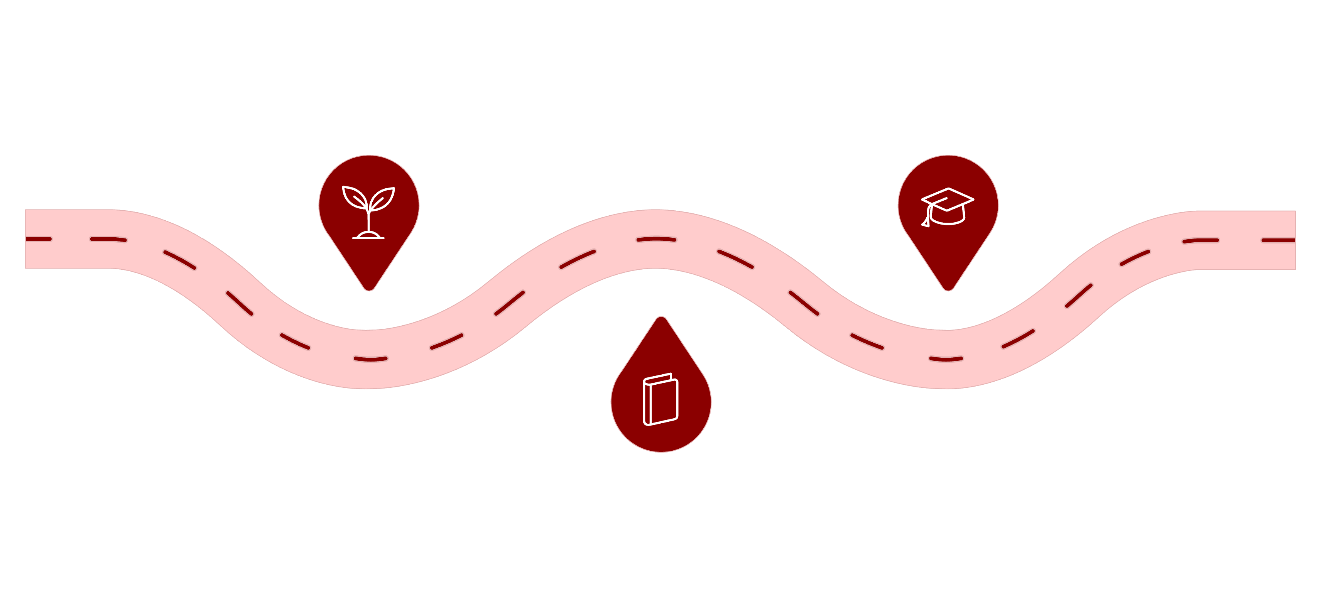
Driving Reading for Pleasure — From First to Last
Reading for Pleasure is championed by those of us working in the first and last year groups of the school. This is no coincidence — it means that the reading culture we nurture in the earliest days of school life carries right through to the final year, creating a continuous, coherent thread of reading passion.
Early Years
Final Year
Plant the seed of reading identity
Confident, lifelong readers
Through School
Nurture a book-rich culture
We are inspired to grow — and ensuring reading for pleasure permeates every year group is how we grow our readers, year on year.

Slide 7
Research-Informed Practice
Using Evidence to Drive Decisions
Our approach to reading for pleasure is not built on instinct alone. We actively seek out the latest research, share it with colleagues, and use it to explain the rationale behind every reading decision we make — from curriculum text choices to library organisation and beyond.
Sharing research with staff builds understanding, trust, and shared ownership of our reading culture. When everyone understands why we do what we do, they become advocates rather than bystanders.
📖 Aidan Chambers
📚 Teresa Cremin
Teachers as readers & reading communities
Book talk & the reading environment
🔬 EEF Evidence
Impact of reading culture on disadvantaged pupils

Slide 8
Early Years: A Standout Success
We are passionate about learning and this year, Early Years showed us what that looks like at its very best.
Our Early Years team has developed their reading for pleasure provision in a number of meaningful ways this year. One success story stands above the rest: encouraging children to create their own stories using random objects found in the learning environment.
Story from Any Object
Child-Led Narratives
Seeds of a Reading Life
Children discovered that stories can begin anywhere — a pebble, a pinecone, a piece of fabric — igniting imagination and authorial confidence.
By placing creative control firmly with the children, we built early reading identities rooted in joy, play, and self-expression.
These early storytelling experiences lay the foundations for a lifelong relationship with books, narrative, and language.

Slide 9
The Culture We've Built Together
A truly book-led school isn't built in a term — it's cultivated, conversation by conversation, book by book, year by year. And we have built something worth celebrating.
The culture across our school now reflects the genuine passion of so many — teachers, support staff, governors, parents, and most importantly, children. Reading for pleasure is not a bolt-on programme; it is the air our school breathes.
Environment Transformed
Collection Diversified
Every space speaks the language of books
Every child can find themselves in our library
1
2
3
4
Curriculum Embedded
Culture Established
Books drive learning across all subjects
Reading for pleasure is who we are

Slide 10
Our Priorities for the Year Ahead
We are inspired to grow — and there is still vital work to do.
1
Finding 'That' Book for Every Child
2
Disadvantaged Children & Reading for Pleasure
We will continue the careful, caring work of identifying children who don't yet see themselves as readers and searching with them, and for them, for the one book that sparks everything. No child should leave our school without having felt the magic of a story made for them.
We will undertake a focused, dedicated piece of work exploring the relationship between disadvantage and reading for pleasure in our school - listening to those children's voices, understanding their barriers, and designing responses that are both compassionate and evidence-informed. We care about togetherness, and that means leaving no reader behind.

